Slide 1
CIRCUIT AND SYSTEMS
COURSE CODE: ETEE-207
By
Mr. LALIT AGARWAL
ASSISTANT PROFESSOR
EEE, MAIT

Slide 2
LECTURE-3

Slide 3
What is a System?
Systems process input signals to produce output signals.
Examples:
A circuit involving a capacitor can be viewed as a system that transforms the source voltage (signal) to the voltage (signal) across the capacitor
A CD player takes the signal on the CD and transforms it into a signal sent to the loud speaker
A communication system is generally composed of three sub- systems, the transmitter, the channel and the receiver.
The channel typically attenuates and adds noise to the transmitted signal which must be processed by the receiver

Slide 4
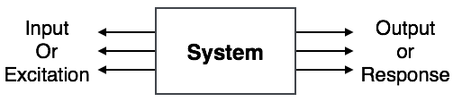
System is a device or combination of devices, which can operate on signals and produces corresponding response. Input to a system is called as excitation and output from it is called as response.
For one or more inputs, the system can have one or more outputs.
Example: Communication System

Slide 5
Types of Systems
Continuous time & Discrete time
Causal & Non-causal
Linear & Non Linear
Time Variant &Time-invariant
Stable & Unstable
Static & Dynamic
Invertible & Non-invertible

Slide 6
Linear time-invariant systems (LTI systems)
Linear time-invariant systems (LTI systems) are a class of systems used in signals and systems that are both linear and time-invariant.
Linear systems are systems whose outputs for a linear combination of inputs are the same as a linear combination of individual responses to those inputs.
Time-invariant systems are systems where the output does not depend on when an input was applied.
These properties make LTI systems easy to represent and understand graphically.

Slide 7
LTI systems are superior to simple state machines for representation because they have more memory. LTI systems, unlike state machines, have a memory of past states and have the ability to predict the future.
LTI systems are used to predict long-term behavior in a system. So, they are often used to model systems like power plants.
Another important application of LTI systems is electrical circuits. These circuits, made up of inductors, transistors, and resistors, are the basis upon which modern technology is built.

Slide 8
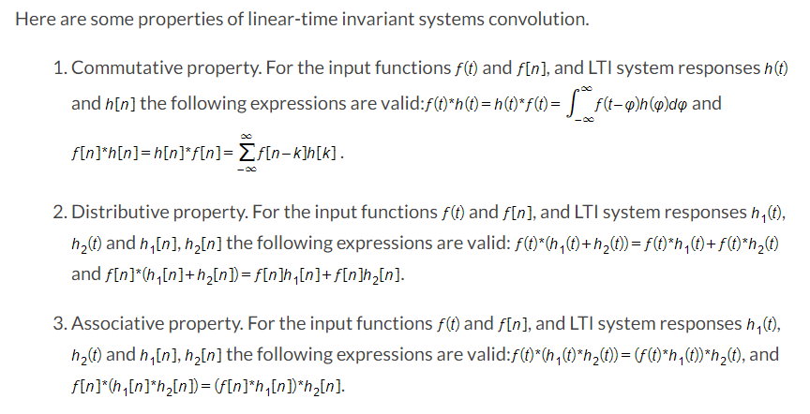

Slide 9
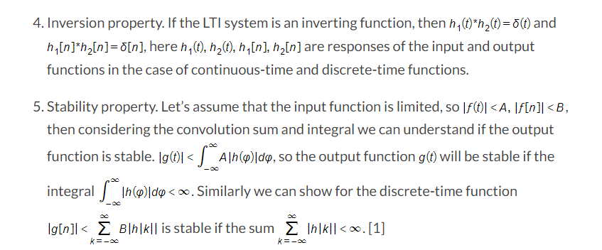

Slide 10
STANDARD TEST SIGNALS OR SINGULARITY FUNCTIONS
To simulate any signal some standard signals , which are realizable in the laboratory environment are given below:
Step function
Ramp function
Impulse function
These singularity functions can be obtained from one another by successive differentiation or integration.

Slide 11
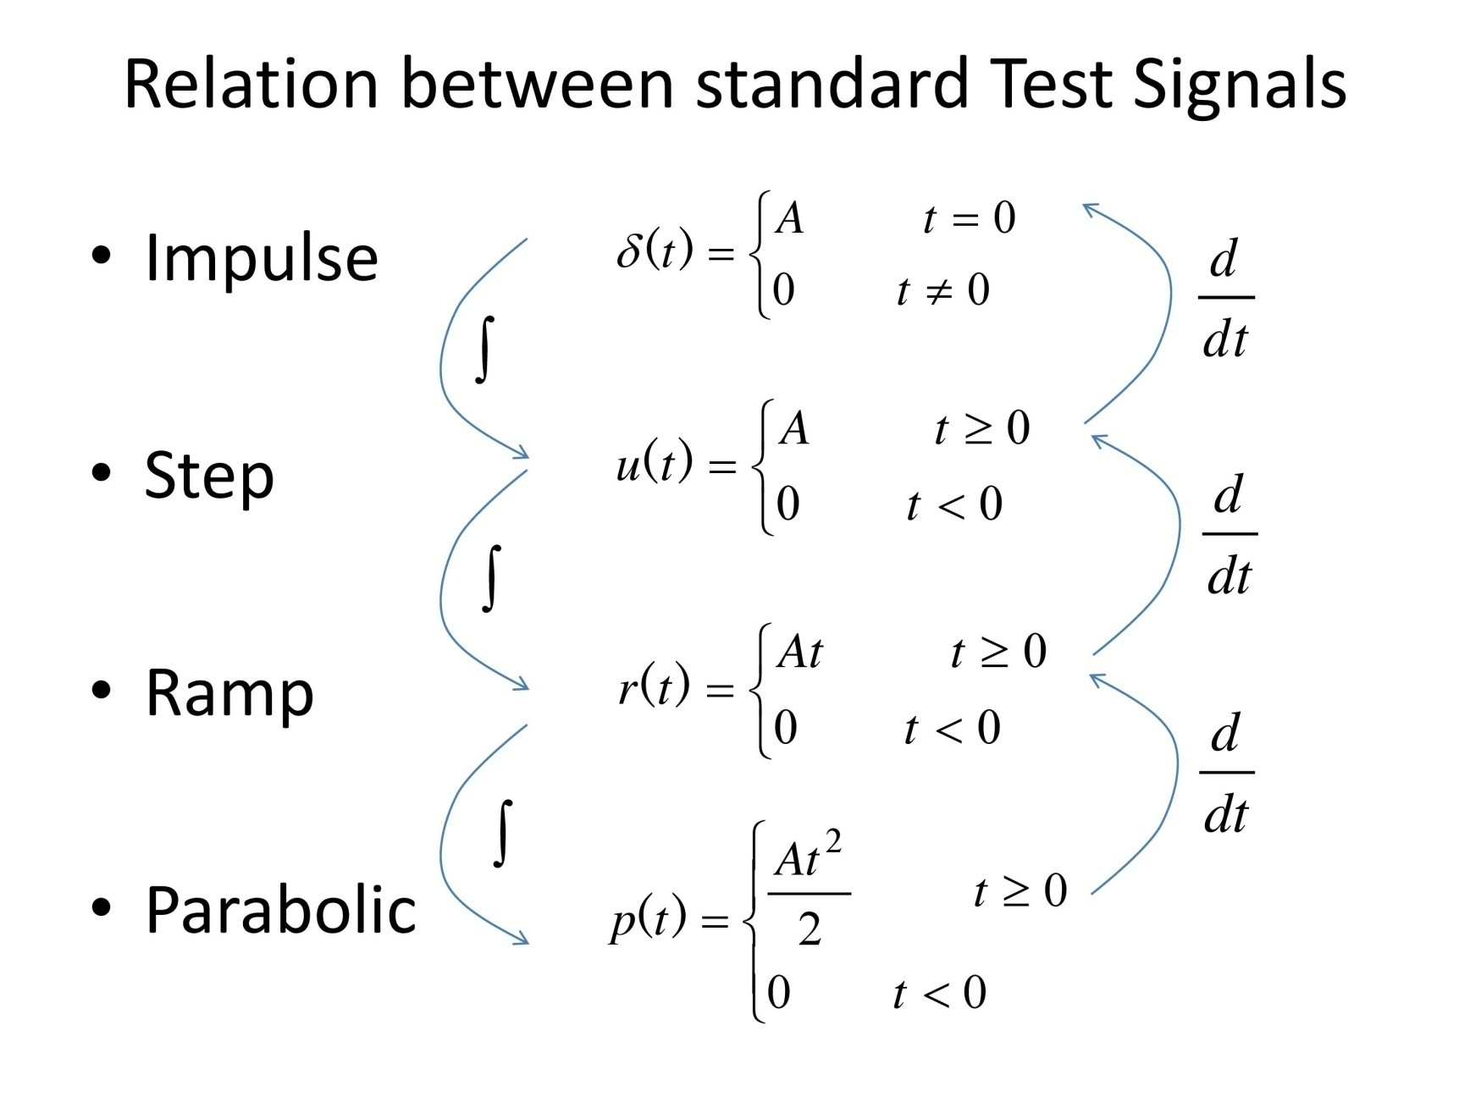

Slide 12
STEP SIGNAL
The step signal fs(t) is defined as,
fs(t) = 0 ; t < 0
K ; t > 0 , where k is the amplitude of the step signal
Now if k =1 here then it will become a unit step signal.
Now the unit step signal U(t) is defined as:
U(t) = 0 ; t < 0
1 ; t > 0
At t = 0 , the value of unit step signal is undefined.
It is used as best test signal.
Area under unit step function is unity.

Slide 13
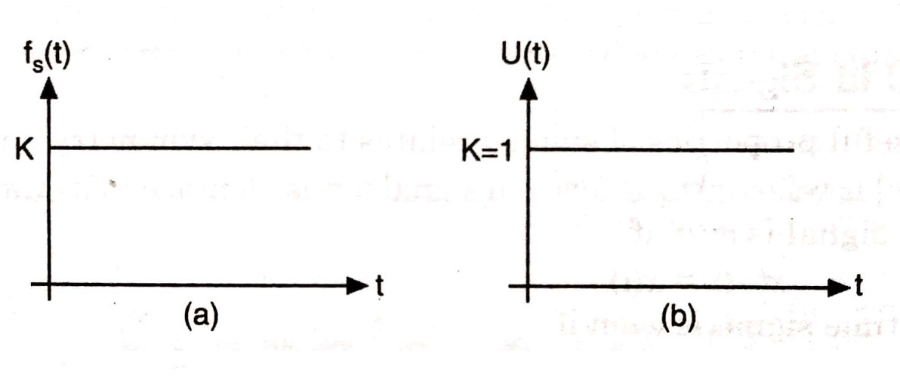
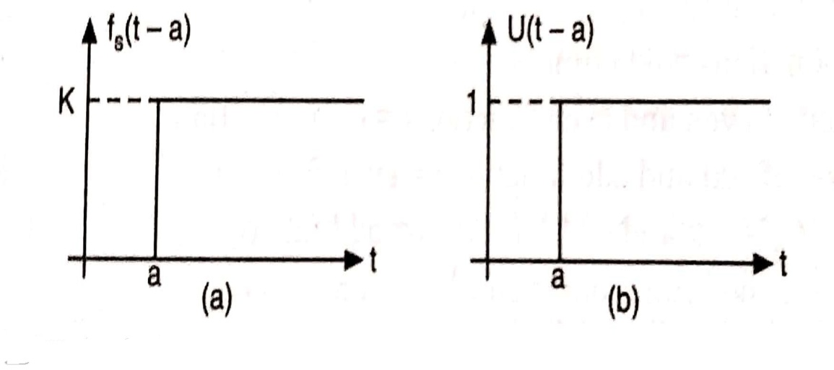
SHIFTED UNIT STEP FUNCTION ( U(t-a))
The shifted or delayed unit step function is defined as:
U(t-a) = 0; t < a
1; t > a
&
fs(t-a) = 0 ; t < a
K ; t > a

Slide 14
RAMP SIGNAL
The ramp signal fr(t) is defined as,
fr(t) = 0 ; t < 0
Kt ; t ⩾ 0 , where k is the slope of the ramp signal.
Now if k =1 here then it will become a unit ramp signal.
Now the unit ramp signal r(t) is defined as:
r(t) = 0 ; t < 0
t ; t ⩾ 0
Area under unit ramp is unity.

Slide 15
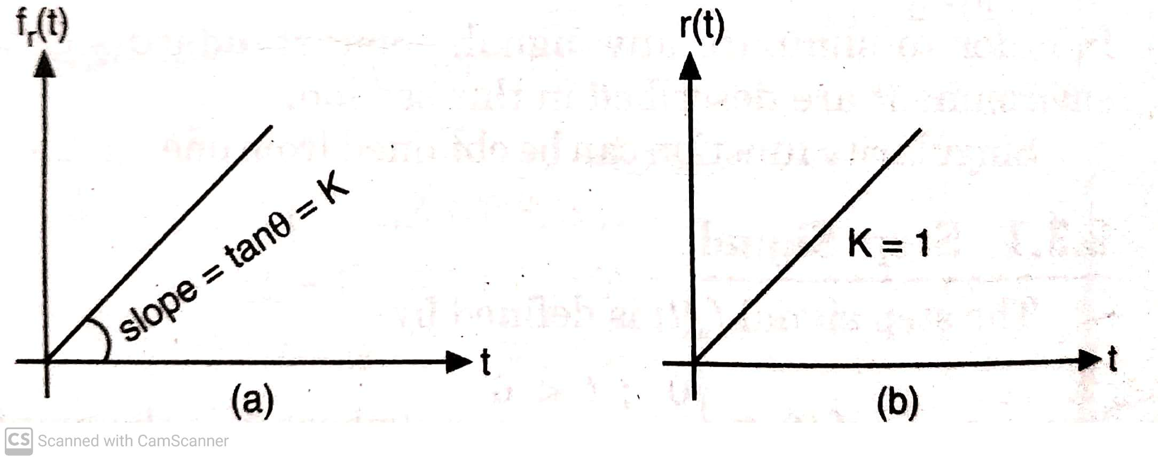
SHIFTED RAMP SIGNAL
The shifted or delayed ramp function is defined as:
fr(t-a) = 0 ; t < a
K(t-a) ; t ⩾ a
&
r(t-a) = 0 ; t < a
(t-a) ; t ⩾ a

Slide 16
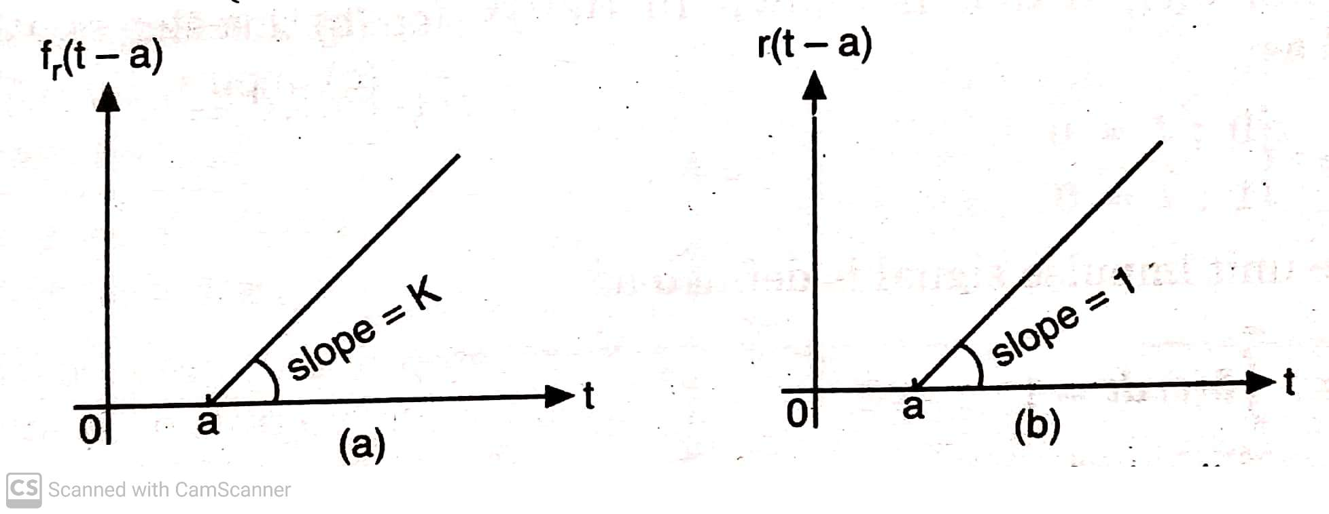
Relationship between Step and Ramp signal
r(t) = t U (t)
r(t-a) = (t-a) U(t-a)
Similarly, fr(t) = k r(t) = Kt U(t)
fr(t-a) = k r(t-a) = k (t-a) U(t-a)

Slide 17
IMPULSE SIGNAL
It is also known as dirac delta function.
The Impulse signal f_{δ}(t) is defined as:
f_{δ}(t) = 0; t ≠ 0
A; t = 0
Where A is the area of the impulse signal and sometimes called as the strength of the impulse.
Now if A = 1, then it is called as Unit impulse function.
Now the unit impulse function δ(t) is defined as:
δ(t) = 0; t ≠ 0
1; t = 0

Slide 18
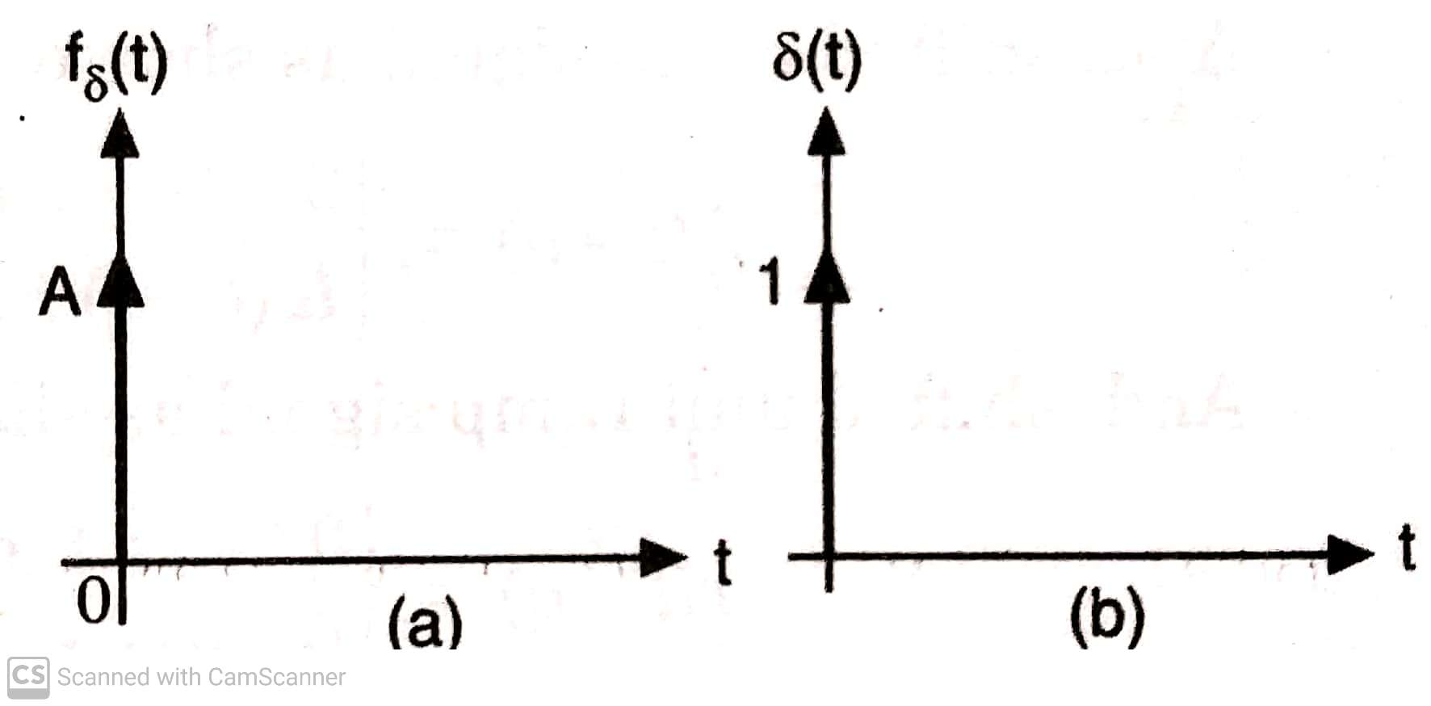
SHIFTED IMPULSE SIGNAL
The shifted or delayed Impulse function is defined as:
f_{δ}(t-a) = 0; t ≠ a
A; t = a
& δ(t-a) = 0; t ≠ a
1; t = a

Slide 19
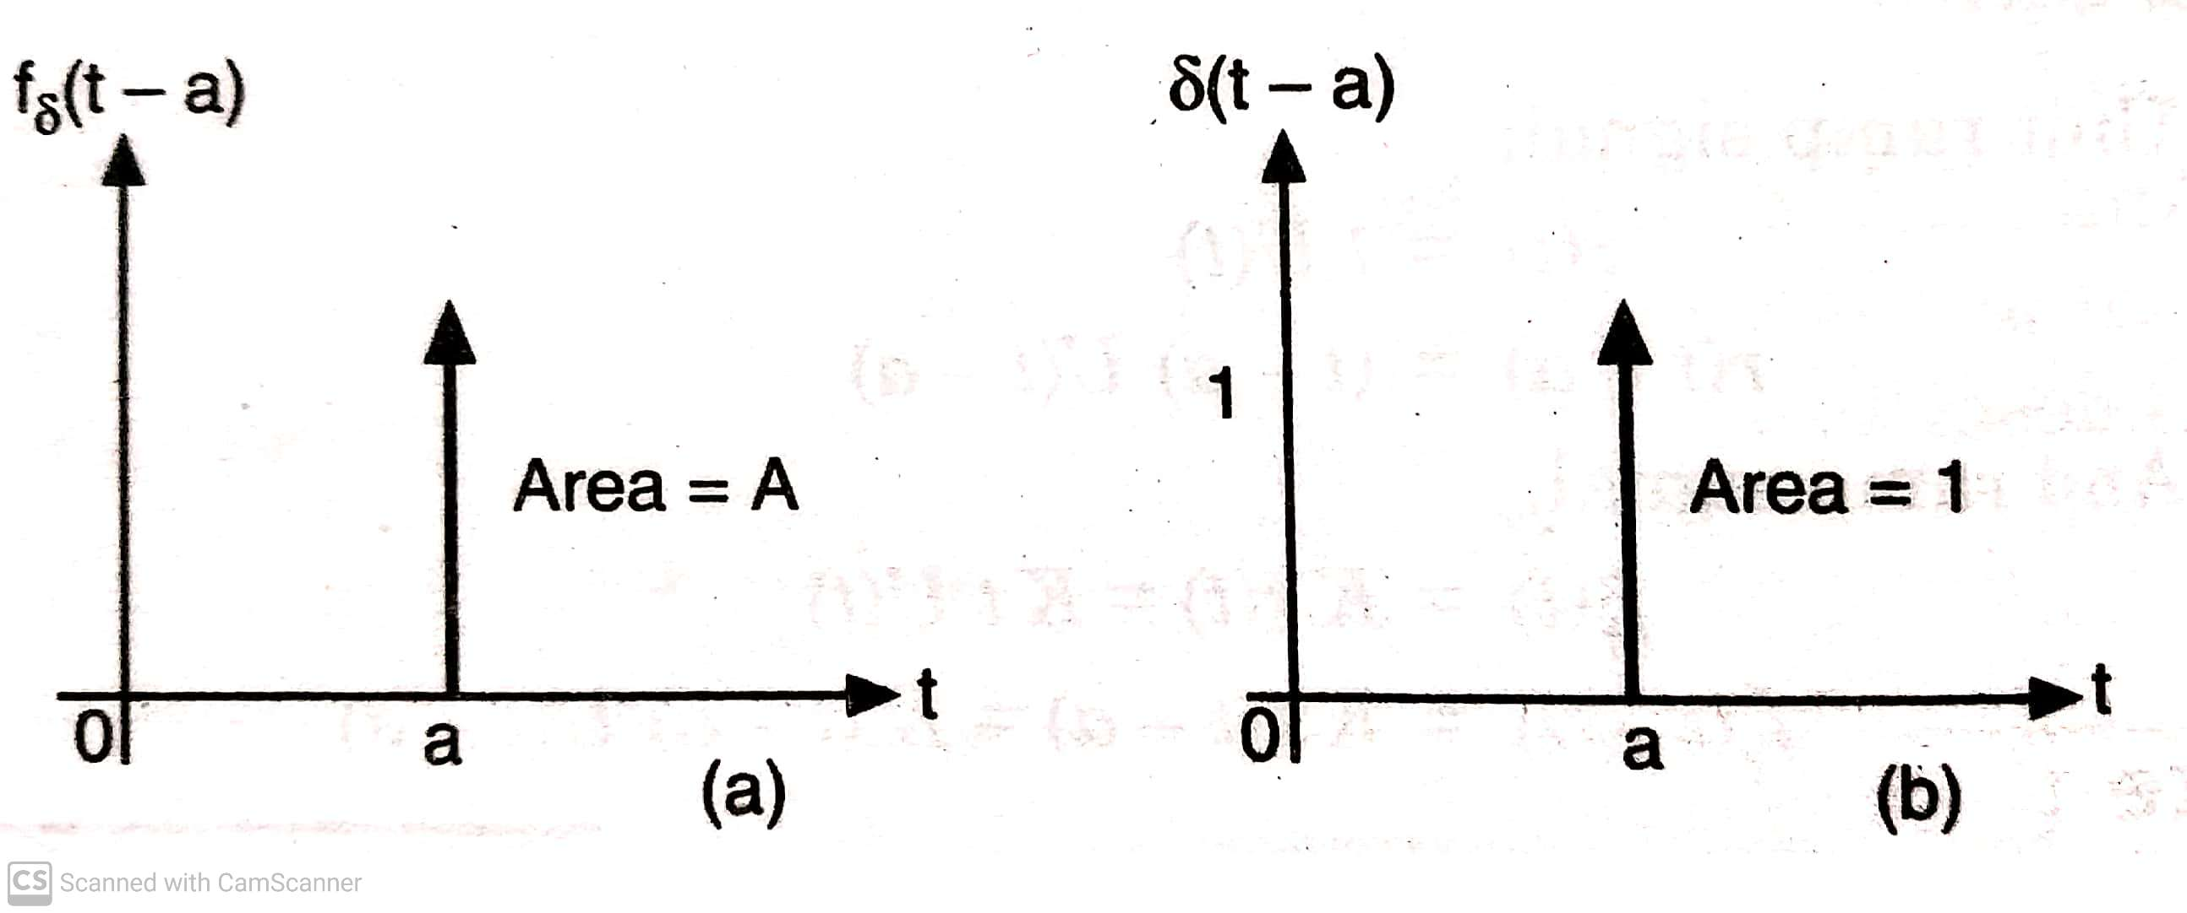
RELATIONSHIP BETWEEN STANDARD SIGNALS:
Derivative of step signal = Impulse signal
Derivative of ramp signal = Step signal
Derivative of parabolic signal = Ramp signal
Integral of Impulse signal = Step signal
Integral of step signal = Ramp signal
Integral of ramp signal = Parabolic signal

Slide 20
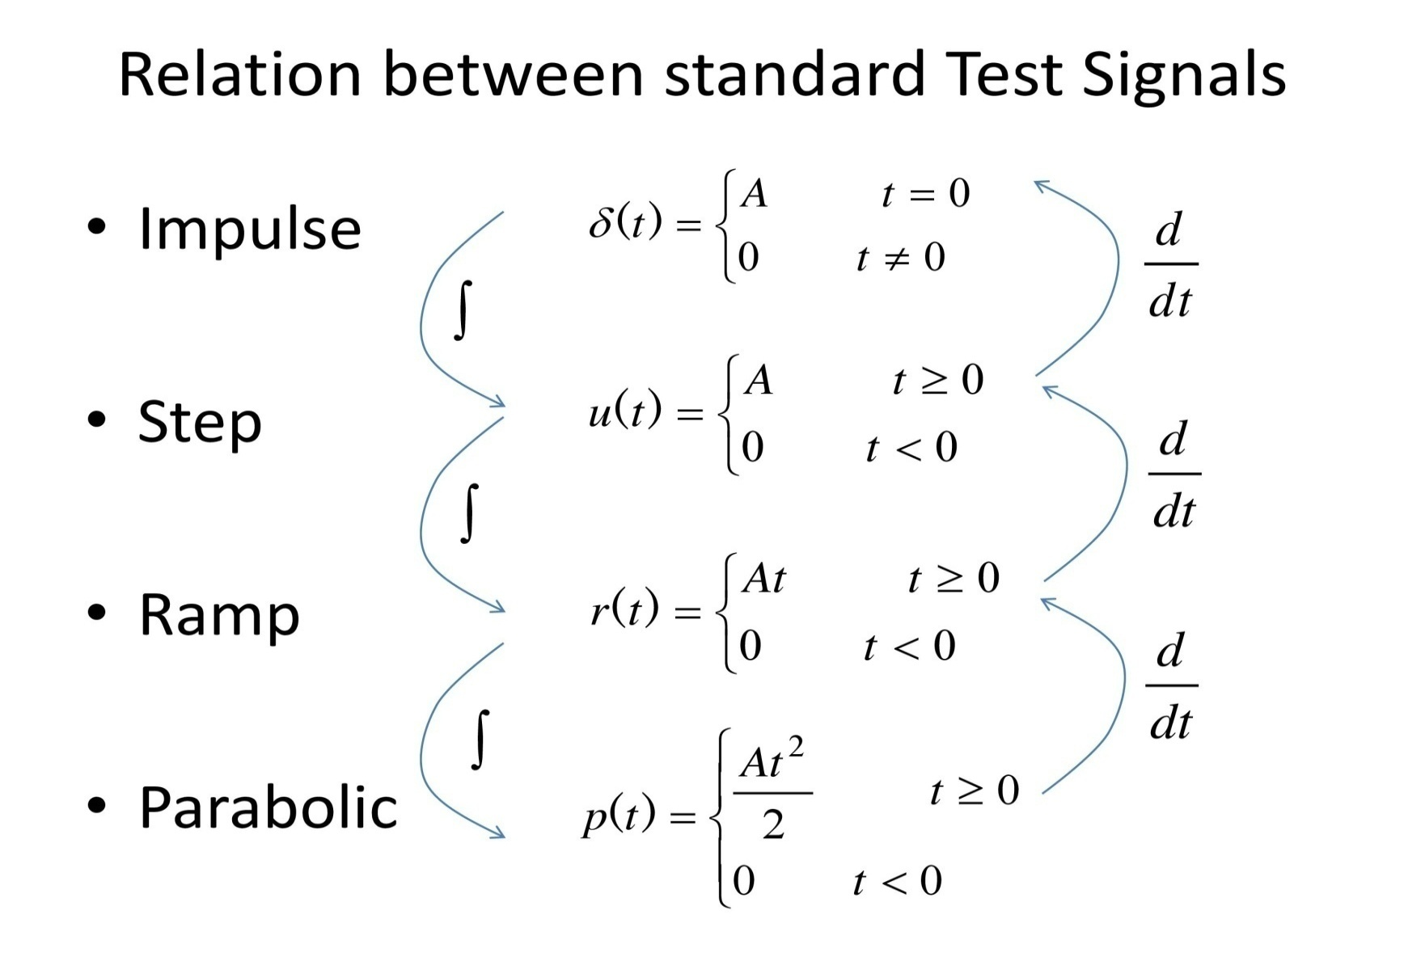
Mathematically;

